Slide 1
Online Mobile Store Application
Group Project

Slide 2
Team Members
1.Vindhyachal Sharma
2.Mounika Molleti
3.Mounika Bora
4.Roopa Sandrana
5.Amrutha Pothuru

Slide 3
Problem Statement
To Create an Application for Online Mobile Store Application
Customer should be able to search,buy, modify and order the mobiles.
Admin should be able to perform
1.Customer Management
2.Mobile Management
3.Order Management

Slide 4
Tools & software's used:-
Tools:-
Spring Tool Suite
Swagger
Postman
Visual studio code
PostgreSQL
Software:-
HTML
CSS
Bootstrap
Java
Type script
Angular

Slide 5
Modules
Customer Module
Admin Module
Category Module
Mobile Module
Cart Module
Payment Module
Order Module

Slide 6
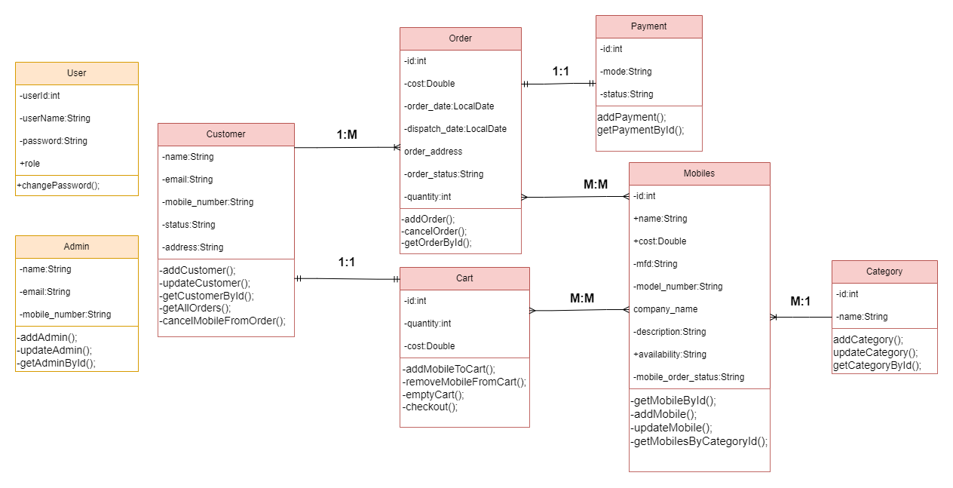
Class-Diagram

Slide 7

Class-Diagram

Slide 8
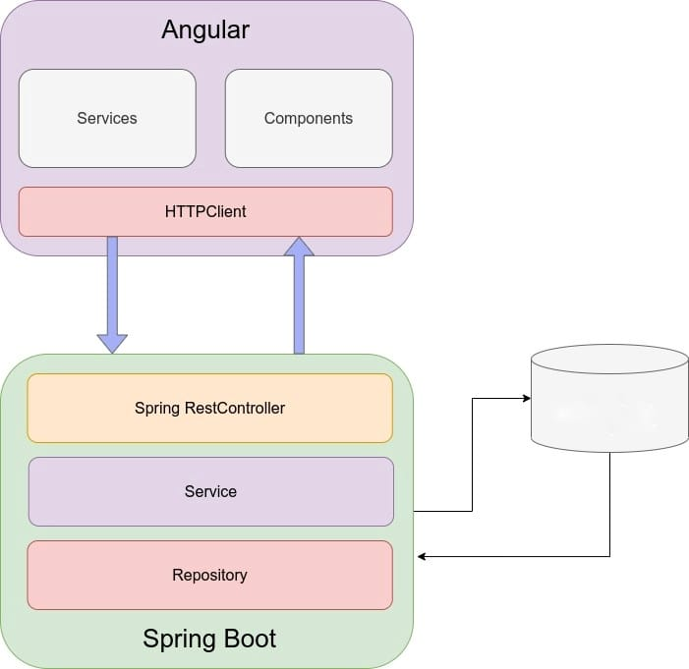
ARCHITECTURE
PostgreSQL

Slide 9

Class-Diagram

Slide 10
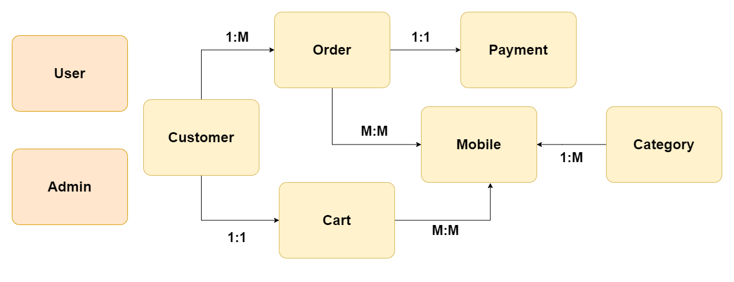
ER-Diagram

Slide 11

ER-Diagram

Slide 12
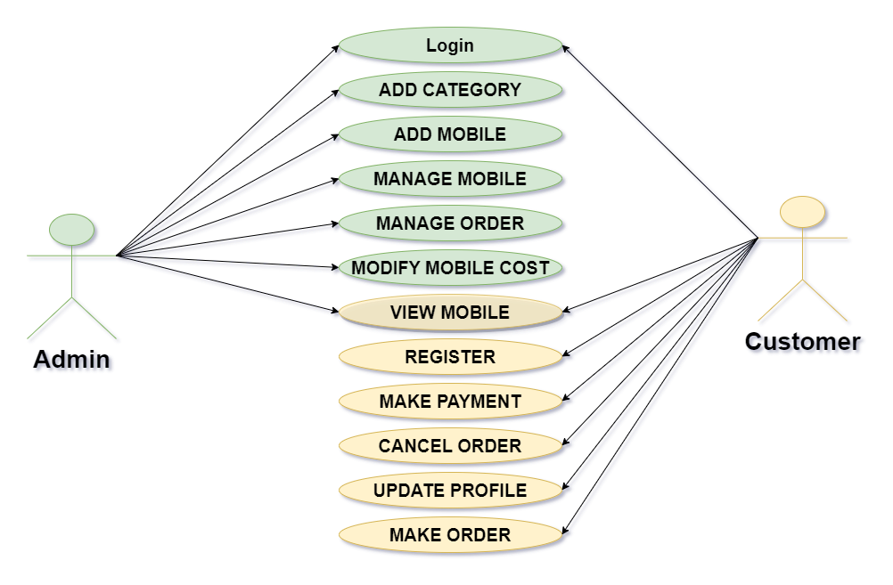
Use Case Diagram

Slide 13
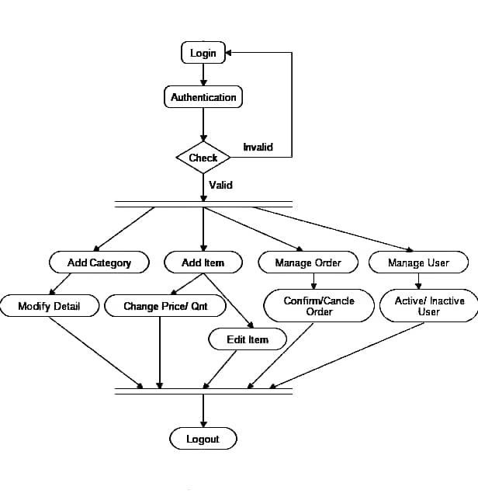
Activity Diagram for Admin Side

Slide 14
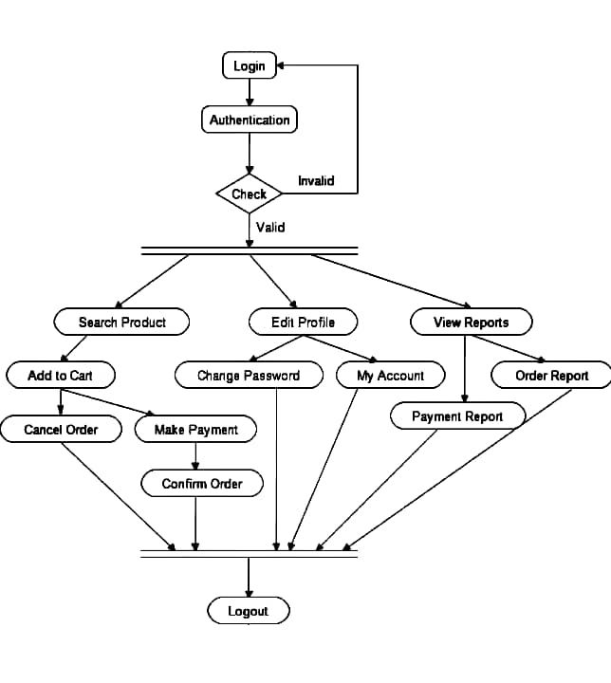
Activity Diagram for User Side
Set Status

Slide 15
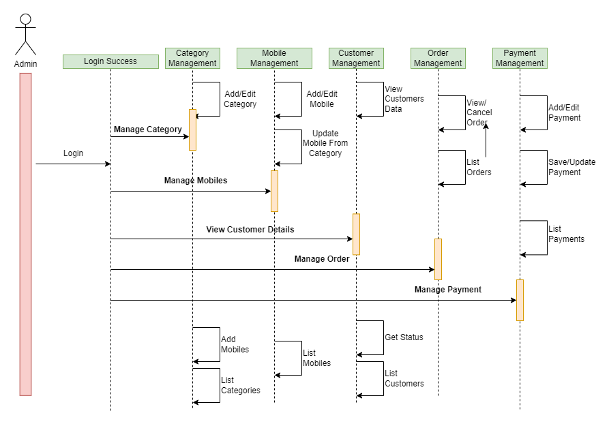
Sequence Diagram For Admin

Slide 16
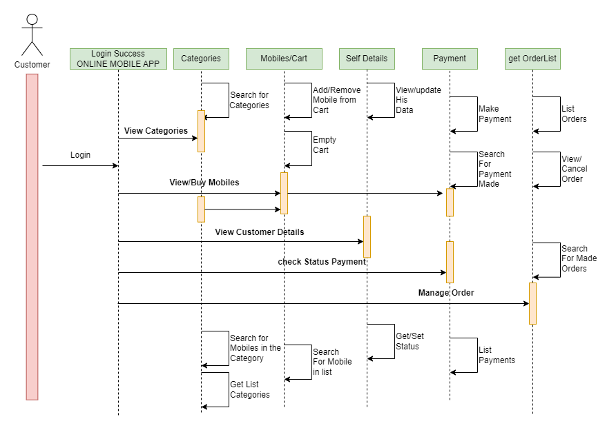
Sequence Diagram For Customer

Slide 17
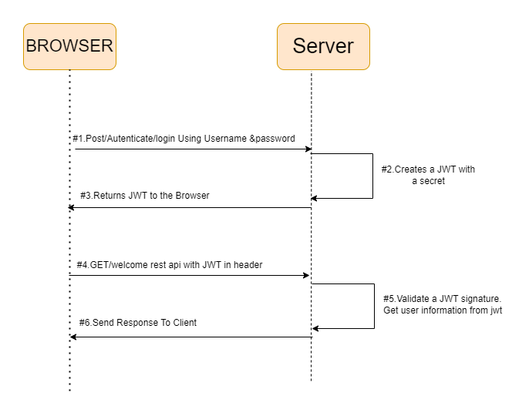
JWT Working

Slide 18



Thank you

